Slide 1
DATA-DRIVEN RETENTION STRATEGY
Telco Customer Churn: Predictive Analytics & Retention Strategy
Preparing an End-to-End Machine Learning System for Proactive Risk Mitigation
Designed for Executive Decision Makers | Based on Telco Churn Dataset

Slide 2
TELCO CUSTOMER CHURN ANALYSIS
Executive Summary: Protecting Recurring Revenue with ML Prioritization
The Business Mandate
Customer churn directly erodes recurring revenue. Because retention teams have limited time and budget, the business objective of this project was not simply to classify customers as 'will churn' or 'will not churn,' but to produce reliable churn probabilities.
This allows the retention team to prioritize activity while explicitly weighing the cost of false positives (wasted retention spend) against false negatives (lost customer lifetime value).
26.54% Churn Rate
Historical baseline (1,869 churners out of 7,043 total customers)
Gradient Boosting
Selected algorithm based on superior cross-validated ROC-AUC (0.849)
Actionable Risk Tiers
Mitigates silent revenue erosion via probability-driven prioritization
Executive Presentation | Grounded in Telco Customer Churn Business Reports | Slide 2 of 10

Slide 3
TELCO CUSTOMER CHURN ANALYSIS
Gradient Boosting Outperformed Other Candidate Models
The Selection Process
Five candidate models were trained and rigorously compared. Performance was evaluated using cross-validation on the training set to prevent overfitting.
Gradient Boosting achieved the highest Mean ROC-AUC of 0.848 in baseline CV, which improved to 0.849 after randomized hyperparameter tuning.
Model | Baseline AUC | Tuned AUC | Tuned SD
Gradient Boosting | 0.848 | 0.849 | 0.009
Logistic Regression | 0.845 | 0.846 | 0.009
Random Forest | 0.824 | 0.844 | 0.006
SVM | 0.800 | 0.835 | 0.004
Decision Tree | 0.656 | 0.830 | 0.009
Executive Presentation | Grounded in Telco Customer Churn Business Reports | Slide 3 of 10

Slide 4
TELCO CUSTOMER CHURN ANALYSIS
Final Holdout Evaluation Confirms Strong Model Reliability
Holdout Confusion Matrix (n = 1,409)
Summary of Evaluation Metrics
• Test ROC-AUC: 0.845
Indicates strong risk ranking capability and excellent class separation.
• Test Accuracy: 80.4%
Overall correct classification, highly reliable given default class ratios.
• Test F1-Score: 0.581
Robust balance of precision and recall on the minority Churn class.
 | Predicted: No Churn | Predicted: Churn
Actual: No Churn | 942 (True Neg) | 93 (False Pos)
Actual: Churn | 183 (False Neg) | 191 (True Pos)
• Precision (67.3%): Avoids wasting budget. 2 out of 3 customers flagged as likely churners are true risk cases.
• Recall (51.1%): At a default 0.50 cutoff, the model captures half of all churners. This recall can be aggressively increased by lowering the probability threshold to 0.30 if cost-of-miss is high.
Executive Presentation | Grounded in Telco Customer Churn Business Reports | Slide 4 of 10

Slide 5
TELCO CUSTOMER CHURN ANALYSIS
Feature Importance: Contract Type and Service Setup Lead Churn Signals
Predictive Signal Ranking
The dominant predictor is Month-to-Month contracts. Having no contractual lock-in makes it effortless for customers to churn. Month-to-month contracts are roughly 2.9 times more influential than tenure.
Fiber optic internet is also associated with high churn, suggesting service experience or pricing issues. A lack of online security and tech support add-ons also carries notable weight.
Predictor Feature | Model Importance
Contract: Month-to-month | 0.409
Tenure (months) | 0.138
Internet Service: Fiber optic | 0.094
Online Security: No | 0.075
Total Charges | 0.065
Executive Presentation | Grounded in Telco Customer Churn Business Reports | Slide 5 of 10

Slide 6
TELCO CUSTOMER CHURN ANALYSIS
Risk Segmentation: Aligning Budgets to Churn Probabilities
Actionable Risk Tiers
Instead of treating all predicted churners identically, customers are segmented into three actionable tiers based directly on their predicted churn probability.
This allows the business to reserve expensive human outreach and incentives for the highest risk cases, while employing automated, low-cost monitoring for medium-risk customers.
HIGH RISK TIER (≥ 0.70) | Immediate Outreach
Flag for direct customer service calls and personalized retention offers.
MEDIUM RISK TIER (0.40 – 0.69) | Targeted Monitoring
Deploy low-cost automated emails, product tutorials, and digital support nudges.
LOW RISK TIER (Probability < 0.40) | Standard CX Programs Only
Represents stable accounts. Keep in standard billing cycles and routine monitoring.
Executive Presentation | Grounded in Telco Customer Churn Business Reports | Slide 6 of 10

Slide 7
TELCO CUSTOMER CHURN ANALYSIS
Opposing Pressures on Customer Loyalty: Drivers of Retention & Churn
Churn Risk Factors (Push Pressures)
• Month-to-Month Contracts
The absolute strongest predictor. Having no contractual lock-in makes it extremely easy for a customer to depart with no friction or exit penalties.
• Fiber Optic Internet Service
Associated with a highly significant 3.49× increase in churn odds. This signals major potential service-quality, technical, or pricing issues.
• Lack of Support Add-Ons
Customers who lack online Security or Tech Support are statistically much more vulnerable to service friction, leading to higher churn rates.
Loyalty Anchors (Pull Pressures)
• Long-Term Commitments
Two-year contracts drastically lock in loyalty, cutting churn odds to 0.43× compared to month-to-month contracts.
• Customer Tenure
Longer tenure acts as a powerful anchor. Relationships built over time have higher switching costs and higher stability.
• DSL Internet Service
DSL users are highly stable and reliable, showing significantly lower odds of leaving compared to fiber customers (0.33× odds ratio).
Executive Presentation | Grounded in Telco Customer Churn Business Reports | Slide 7 of 10

Slide 8
TELCO CUSTOMER CHURN ANALYSIS
Strategic Recommendations: Data-Driven Churn Mitigation
1. Prioritize High Risk
Execute proactive retention offers and personal outreach for the high-risk segment (churn probability ≥ 0.70). These customers represent the greatest revenue risk and offer the highest expected return on intervention.
2. Drive Contract Conversion
Identify early-lifecycle month-to-month customers with high tenure-propensity and offer targeted discounts or loyalty bonuses to transition them onto stable 1-year or 2-year contracts.
3. Audit Service Vulnerabilities
Investigate service-related churn among fiber-optic subscribers and those missing security support. Product teams must review service delivery and packaging to address this value gap.
Executive Presentation | Grounded in Telco Customer Churn Business Reports | Slide 8 of 10

Slide 9
TELCO CUSTOMER CHURN ANALYSIS
Technical Appendix: Cost-Sensitive Decision Optimization
Churn Cost Asymmetry (The 10:1 Ratio)
• False Negative (Missed Churner) Cost: $500
Occurs when an at-risk customer is predicted as stable, leading to a complete loss of their remaining Customer Lifetime Value (CLV).
• False Positive (False Alarm) Cost: $50
Occurs when a loyal customer is offered a retention package, incurring only the low cost of a standard contract discount or support add-on.
• Asymmetric Cost Ratio: 10:1
Because missing a churner is 10 times more expensive than over-targeting a stable customer, the default 0.50 cutoff leads to major profit leaks.
Optimal Threshold & Campaign Performance
• Optimized Decision Cutoff: T = 0.12
Determined by evaluating our Gradient Boosting probability scores against retention economics to minimize total business loss.
• Maximizing Churn Recovery (83.7% Capture)
Lowers missed churners (FN) from 183 down to just 61, identifying 313 of the 374 actual churners in our holdout set.
• Outstanding Campaign ROI: 147.6%
Generates $46,650 in net revenue saved. Every dollar of your highly targeted $31,600 retention budget yields $1.48 in preserved customer equity.
Executive Presentation | Grounded in Telco Customer Churn Business Reports | Slide 9 of 10

Slide 10
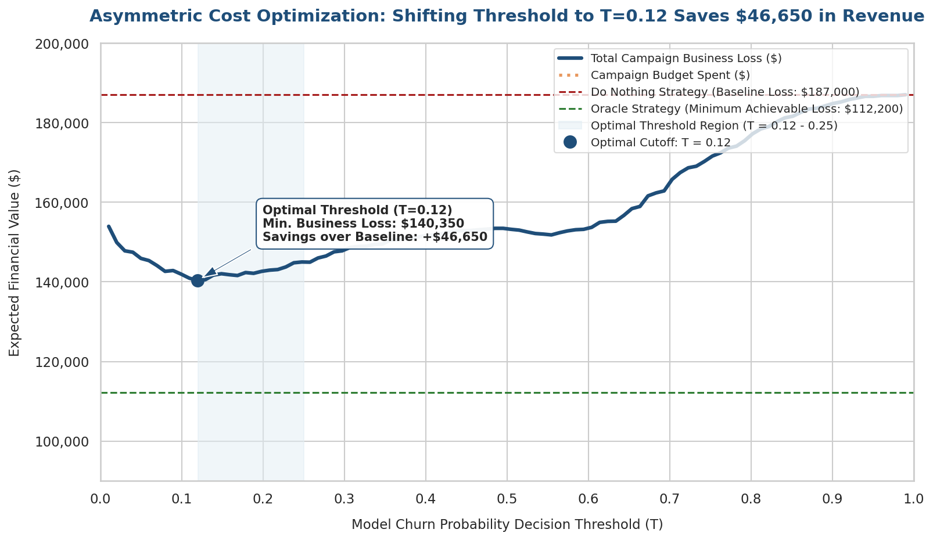
TELCO CUSTOMER CHURN ANALYSIS
Expected Business Loss Curve & Targeted Retention Budget
Visual Analysis Takeaways
• Expected Loss Minimization
The curve shows the optimal expected loss valley at T = 0.12, reducing business loss from $187,000 (Do Nothing baseline) down to just $140,350.
• Dynamic Budget Allocation
Operating at T = 0.12 consumes a highly targeted campaign budget of $31,600. Mass marketing (T = 0) would cost $70,450, severely diluting resources.
• Operational Capacity Tool
Executives can use this expected loss curve as a slider: adjusting the threshold upwards to match call-center limits, or downwards when retention capacity expands.
Executive Presentation | Grounded in Telco Customer Churn Business Reports | Slide 10 of 10

